Slide 1
Advanced Machine Learning For Design
Lecture 3 - Machine Learning and Natural Language Processing / Part 2
Evangelos Niforatos
04/10/2023
aml4d-ide@tudelft.nl
https://aml4design.github.io/

Slide 2
Admin

Slide 3
Assignment 1
Feedback published
In general: well done!
Specifically
Few of you did not engage with programming
Needed for Assignment 2!
Unstructured analysis
It is OK to give a qualitative understanding, but clients like numbers and some statistics too!

Slide 4
Previously, on AML4D….

Slide 5
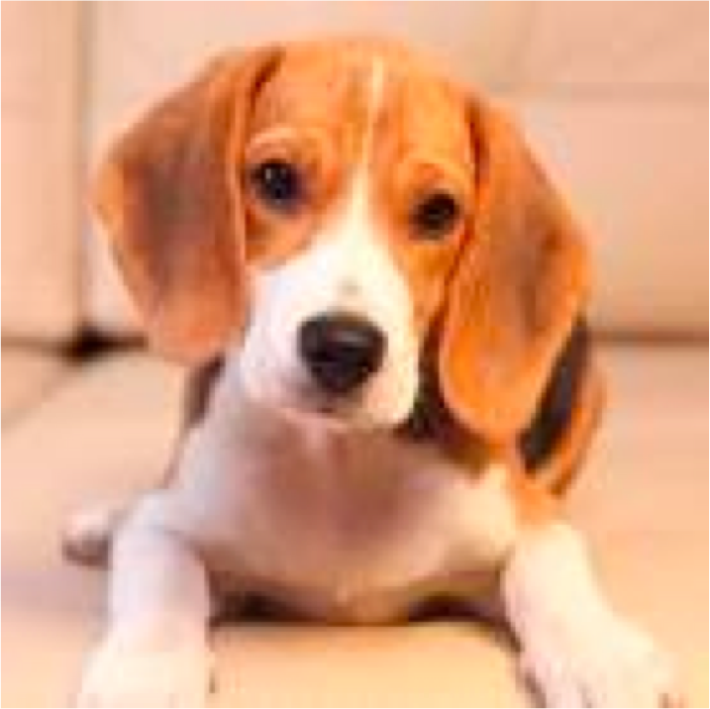
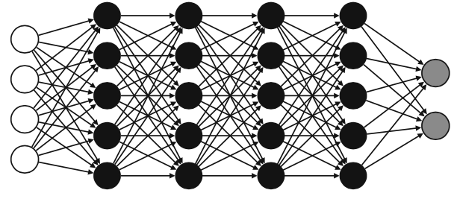
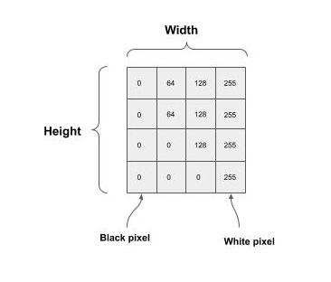
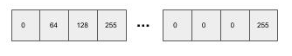
Machine Learning
Machine learning: observe a pattern of features and attempt to imitate it in some way
A feature is an individual measurable property or characteristic of a phenomenon
Choosing informative, discriminating and independent features are essential for well-working ML
Feature
Feature
Feature
Feature
Label
sepal_lenght | sepal_width | petal_lenght | petal_width | Class
5.0 | 3.3 | 1.4 | 0.2 | Iris-setosa
7.0 | 3.2 | 4.7 | 1.4 | Iris-versicolor
5.7 | 2.8 | 4.1 | 1.3 | Iris-versicolor
6.3 | 3.3 | 6.0 | 2.5 | Iris-virginica
Record / Sample / Data Item
Dataset Size
Label Value
Dataset Dimensionality
Feature Value
d = width x height
Input layer size = d
Features
Images —> pixel values (e.g. B/W, RGB)
Numbers —> OK
What about text?
Math
10
9
8
7
6
5
4
3
2
1
Test
1
2
3
4
5
6
7
8
9
10

Slide 6
Textual documents
A sequence of alphanumerical characters
Short: e.g. tweets
Long: e.g Web documents, interview transcripts
Features are (set of) words
Words are also syntactically and semantically organised
Feature values are (set of) words occurrences
Dimensionality —> at least dictionary size
Document
I | Wear | Mask | … | W(n) | Class
1 | 1 | 1 |  | 0 | Spam
0 | 0 | 1 |  | 0 | Not Spam
 |  |  |  |  | Spam
Notes:
This modality is natural language or text. Longer documents, including formal documents and publications, are a part of the same modality. The syntax, semantics, and pragmatics of human language is complicated. One way of dealing with text includes parsing the language and creating a syntax tree. Another way is representing text as sparse structured data by counting the existence of individual words, pairs of words, triplets of words, and so on in a document. These bag-of-words or n-gram representations are currently being superseded by a third way: sophisticated large language models, a type of foundation model, trained on vast corpora of documents. Just like in learning spatial representations of images, the learning of language models can be found with many different biases, especially when the norms of the language in the training corpus do not match the norms of the application. A language model trained on a humongous pile of newspaper articles from the United States will typically not be a good foundation for a representation for short, informal, code-mixed text messages in East Africa.2

Slide 7
Main types of NLP Tasks
Label a region of text
e.g. part-of-speech tagging, sentiment classification, or named-entity recognition
Link two or more regions of text
e.g. coreference (are two mentions of a real-world thing (e.g. a person, place, or some other named entity( are in fact referencing the same real-world thing?
Fill in missing information (missing words) based on context
Notes:
NLP tasks seek to do one of three things: label a region of text (such as part-of-speech tagging, sentiment classification, or named-entity recognition); link two or more regions of text (such as coreference, which tries to answer whether two mentions of
a real-world thing are in fact referencing the same real-world thing, where the real-world thing is generally a person, place, or some other named entity); or try to fill in missing information (missing words) based on context.

Slide 8
Language Representation
Language = vocabulary and its usage in a specific context captured by textual data

Slide 9

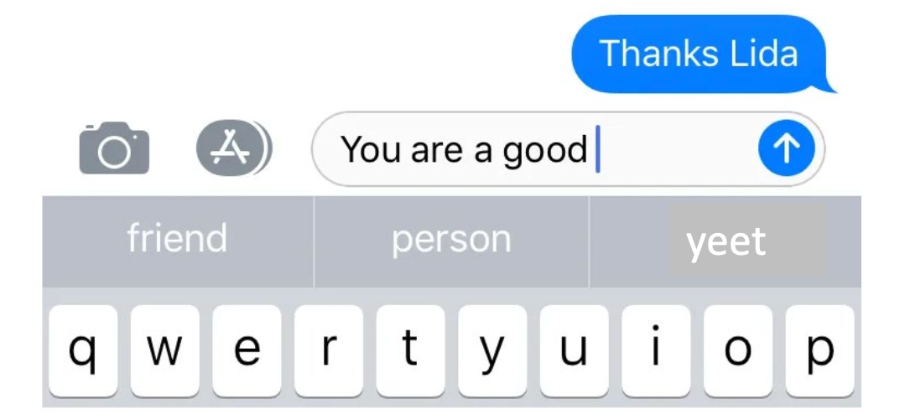
Language Modeling
A collection of statistics learned over a particular language
Often used to
Measure how “important” (or descriptive) a word is in a given document collection
e.g. find the set of words that best describe multiple clusters (see Group Assignment 1)
Predict how likely a sequence of words is to occur in a given context
e.g. find the word(s) that is more likely to occur next
A good language model will give this sentence a high probability because this is a completely valid sentence, syntactically and semantically
These probabilities are almost always empirically derived from a text corpora
Notes:
Why would you want to compute the probability of a word sequence? In many applications, the goal is to produce word sequences as output:
• In machine translation (chapter 18), we convert from text in a source language to text in a target language.
• In speech recognition, we convert from audio signal to text.
• In summarization (§ 16.3.4; § 19.2), we convert from long texts into short texts.
• In dialogue systems (§ 19.3), we convert from the user’s input (and perhaps an external knowledge base) into a text response.

Slide 10
The issue with representing words
Words are discrete symbols
Machine-learning algorithms cannot process symbolic information as is
We need to transform the text into numbers
But we also need a way to express relationships between words!
Notes:
The first and arguably most important common denominator across all NLP tasks is how we represent words as input to any of our models. Much of the earlier NLP work that we will not cover treats words as atomic symbols. To perform well on most NLP tasks we first need to have some notion of similarity and difference between words.
Neural networks are pure mathematical computation models that can only deal with numbers. They can’t do symbolic operations such as concatenating two strings and conjugating a verb to past tense, unless they are all represented by numbers and arithmetic operations

Slide 11
A simple approach
Assign an incremental number to each word
cat = 1
dog = 2
pizza = 3
Problem: There is no notion of similarity!
Is a cat as semantically close (similar) to a dog as a dog is to a pizza
Also, no arithmetic operations
Does it make sense to calculate Dog - Cat to establish similarity?
Notes:
The first and arguably most important common denominator across all NLP tasks is how we represent words as input to any of our models. Much of the earlier NLP work that we will not cover treats words as atomic symbols. To perform well on most NLP tasks we first need to have some notion of similarity and difference between words.

Slide 12
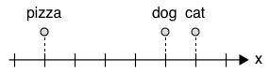
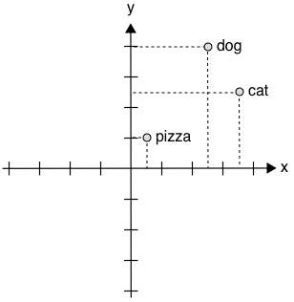
Word Embeddings
Embed (represent) words in a numerical n-dimensional space
Approach 1: assign numbers to words, and put semantically related words close to each other
We can now express that “dog is more related to cat than to pizza”
But is pizza more related to dog than to cat?
Approach 2: assign multiple numbers (a vector) to words
e.g. a 2-dimensional space
cat = [4,2], dog = [3,3], pizza = [1,1]
We can calculate distance (and similarity)
e.g. Euclidean, or Cosine (angles)
But what is the meaning of an axis?
1-Dimension
2-Dimensions
word representation

Slide 13
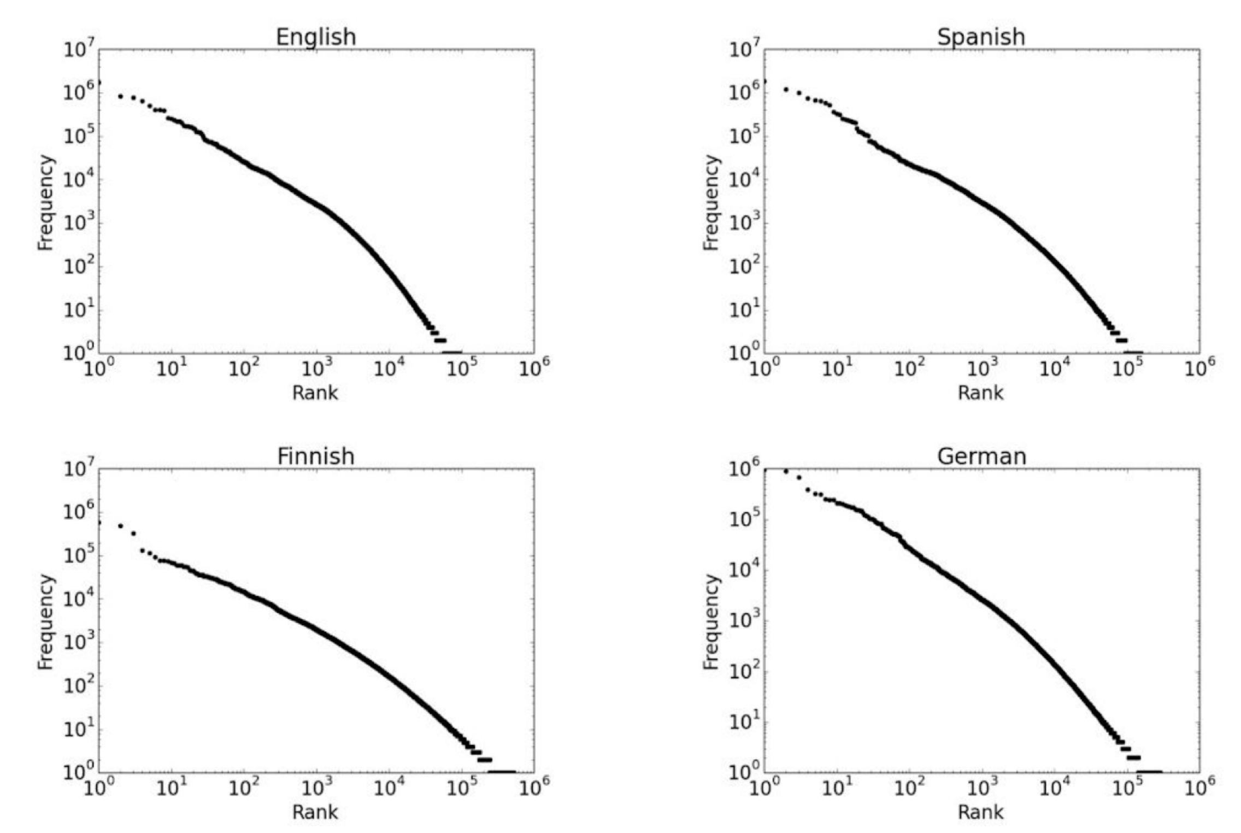
One-Hot Encoding
Each word in the vocabulary is represented by a one-bit position in a HUGE (sparse) vector
Vector dimension = size of the dictionary
There are an estimated 13 million tokens for the English language
For example
cat = [0,0,0,0,0,0,0,0,0,0,1,0,0,0,…,0]
dog = [0,0,0,0,0,0,0,1,0,0,0,0,0,0,…,0]
pizza = [1,0,0,0,0,0,0,0,0,0,0,0,0,0,…,0]
Problems:
The size of the vector can be huge
Remember Zip’s law? Easy to reach 10⁶ words
But we can use stemming, lemmatisation, etc
Still, no notion of similarity
Each word is an independent, discrete entity
Words ordered by their frequency
Notes:
In the NLP field, this is called a one-hot encoding: at each time step, only one of the inputs—the one corresponding to the word being fed to the network—is “hot” (non-0). The one-hot encoding used to be a standard way to input words to neural networks. But it has a problem:
Mitchell, Melanie. Artificial Intelligence (p. 187). Farrar, Straus and Giroux. Kindle Edition.
an arbitrary assignment of numbers to words doesn’t capture any relationships among words.

Slide 14
Independent and identically distributed words assumption
The simplest (inaccurate) language model assumes that each word in a text appears independently
The text is modelled as generated by a sequence of independent events
The probability of a word can be estimated as the number of times a word appears in a text corpus
But high probability does not mean important (or descriptive)

Slide 15
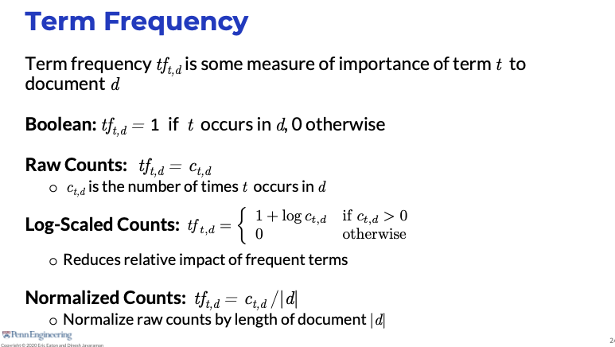
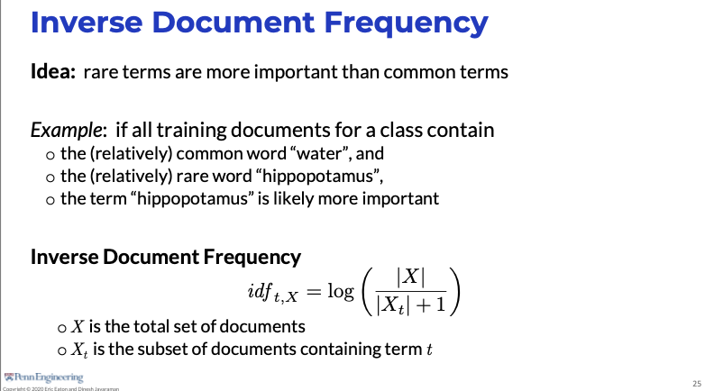
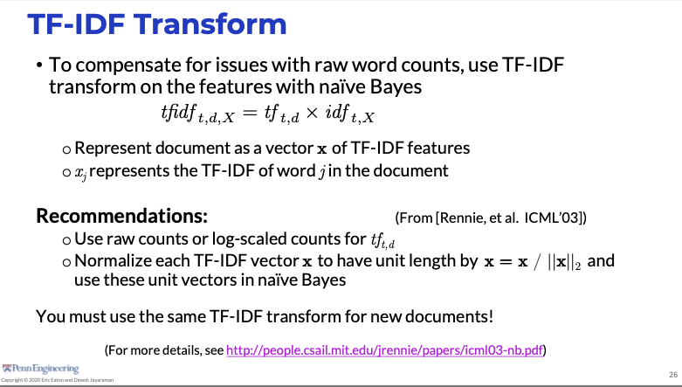
Measuring the importance of words
Term frequency TF
Measuring the importance of a word t to a document d
The more frequent, the more important to describe the document
Inverse document frequency IDF
Measuring the importance of a word t to a document collection
Rare terms are more important than common terms
If all (training) documents contain the word design, but only a few selected documents contain the word “machine”, then machine is more discriminative in the document collection
TF-IDF
“Scaling” of a word’s importance (in a document) based on both its frequency and collections’ importance

Slide 16
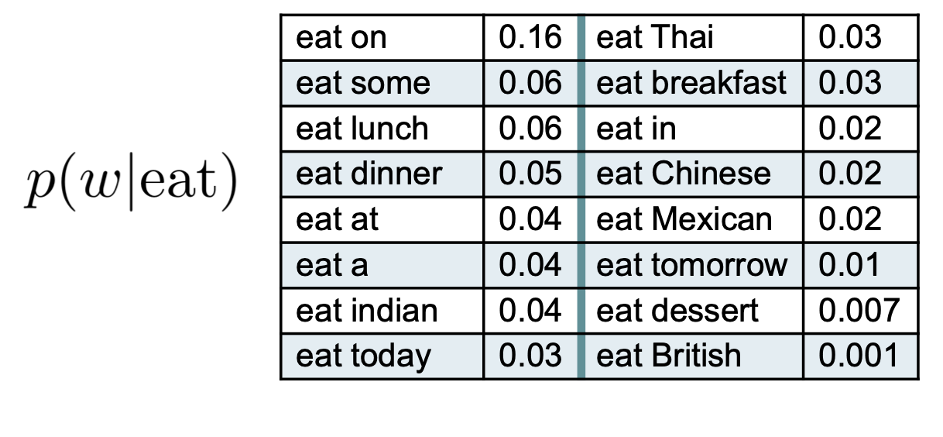
N-gram Language models
A more accurate model takes into account the conditional probabilities among adjacent words (e.g. bi-grams)
We try to calculate the probability of a word w given a word w⁻¹
e.g. computer network vs. computer pear
The model is more accurate but it is more difficult to be estimated with accuracy
The N-grams model dependencies deriving from
Grammatical rules
e.g. an adjective is likely to be followed by a noun
Semantic restrictions
e.g. Eat a pear vs. Eat a crowbar
Cultural restrictions
e.g. Eat a cat
The probabilities depend on the considered contexts
Notes:
A simple approach to computing the probability of a sequence of tokens is to use a relative frequency estimate

Slide 17
Limits of N-grams based Language Models
The model accuracy increases with N
The syntactic/semantic contexts are better modelled
The drawback is the difficulty in the model parameter estimation (the conditional probabilities)
If the dictionary contains D terms (word forms with inflexions) there are D^{N} N-grams
A corpus C words “long” contains C N-grams (each word generates exactly a sample for one N-gram)
For a significant estimate of the parameters, the corpus size should increase exponentially in the order N of N-grams
f.i. given D=30000 there are 900 million bigrams and a corpus with C=1.000.000 words would not be adequate to compute an accurate estimate for the language (especially for the rarest bigrams)
Hence, the resulting model can be heavily dependent on the corpus exploited in the estimation of the parameters
They do not generalise to unseen words sequences
What about using machine learning?
Notes:
This estimator is unbiased: in the theoretical limit of infinite data, the estimate will be correct. But in practice, we are asking for accurate counts over an infinite number of events, since sequences of words can be arbitrarily long.
The hyperparameter n controls the size of the context used in each conditional probability. If this is miss-pecified, the language model will perform poorly. Let’s consider the potential problems concretely.
When n is too small. Consider the following sentences:
(6.3) Gorillas always like to groom their friends.
(6.4) The computer that’s on the 3rd floor of our office building crashed.
In each example, the words written in bold depend on each other: the likelihood of their depends on knowing that gorillas is plural, and the likelihood of crashed de- pends on knowing that the subject is a computer. If the n-grams are not big enough to capture this context, then the resulting language model would offer probabili- ties that are too low for these sentences, and too high for sentences that fail basic linguistic tests like number agreement.
When n is too big. In this case, it is hard good estimates of the n-gram parameters from our dataset, because of data sparsity. To handle the gorilla example, it is necessary to model 6-grams, which means accounting for V 6 events. Under a very small vocab- ulary of V = 104, this means estimating the probability of 1024 distinct events.
N -gram language models have been largely supplanted by neural networks. These mod- els do not make the n-gram assumption of restricted context; indeed, they can incorporate arbitrarily distant contextual information, while remaining computationally and statisti- cally tractable.

Slide 18
Representing words by their contexts
When a word w appears in a text, its context is the set of words that appear nearby (within a fixed-size window)
Distributional semantics: A word’s meaning is given by the words that frequently appear close-by
For example: look at the following contexts:
(1) A bottle of ___ is on the table
(2) Everybody likes ___
(3) Don’t have ___ before you drive
(4) We make ___ out of corn
What other words fit into these contexts?
tezgüino
 | 1 | 2 | 3 | 4
tezgüino | 1 | 1 | 1 | 1
loud | 0 | 0 | 0 | 0
motor oil | 1 | 0 | 0 | 1
tortillas | 0 | 1 | 0 | 1
choices | 0 | 1 | 0 | 0
wine | 1 | 1 | 1 | 0
word representation
Contextual similarity
(Example from Lin, 1998)
Notes:
Here’s a word you may not know: tezgu ̈ino (the example is from Lin,1998). If you do not know the meaning of tezgu ̈ino, then you are in the same situation as a natural language processing system when it encounters a word that did not appear in its training data. Now suppose you see that tezgu ̈ino is used in the following contexts:
How about: loud, motor oil, tortillas, choices, wine?
Each row of Table 14.1 is a vector that summarizes the contextual properties for each word, with a value of one for contexts in which the word can appear, and a value of zero for contexts in which it cannot. Based on these vectors, we can conclude: wine is very similar to tezgu ̈ino; motor oil and tortillas are fairly similar to tezgu ̈ino; loud is completely different.
These vectors, which we will call word representations, describe the distributional properties of each word.
The distributional hypothesis has stood the test of time: distributional statistics are a core part of language technology today, because they make it possible to leverage large amounts of unlabeled data to learn about rare words that do not appear in labeled training data.
Distributional statistics have a striking ability to capture lexical semantic relationships such as analogies

Slide 19
Representing words by their contexts
When a word w appears in a text, its context is the set of words that appear nearby (within a fixed-size window)
Distributional semantics: A word’s meaning is given by the words that frequently appear close-by
For example: look at the following contexts:
(1) A bottle of ___ is on the table
(2) Everybody likes ___
(3) Don’t have ___ before you drive
(4) We make ___ out of corn
What other words fit into these contexts?
“You shall know a word by the company it keeps”
The distributional hypothesis, John Firth (1957)
The contexts in which a word appears tell us a lot about what it means.
Words that appear in similar contexts have similar meanings
Notes:
Here’s a word you may not know: tezgu ̈ino (the example is from Lin,1998). If you do not know the meaning of tezgu ̈ino, then you are in the same situation as a natural language processing system when it encounters a word that did not appear in its training data. Now suppose you see that tezgu ̈ino is used in the following contexts:
How about: loud, motor oil, tortillas, choices, wine?
That is, the meaning of a word can be defined in terms of other words it tends to occur with, and the words that tend to occur with those words, and so on. Abhorred tends to occur in the same contexts as hated. Laughed tends to occur with the same words that humor finds in its company. In linguistics, this idea is known more formally as distributional semantics. The underlying hypothesis of distributional semantics is that “the degree of semantic similarity between two linguistic expressions A and B is a function of the similarity of the linguistic contexts in which A and B can appear.”11 Linguists often make this more concrete via the idea of a “semantic space.”
Mitchell, Melanie. Artificial Intelligence (p. 188). Farrar, Straus and Giroux. Kindle Edition.

Slide 20
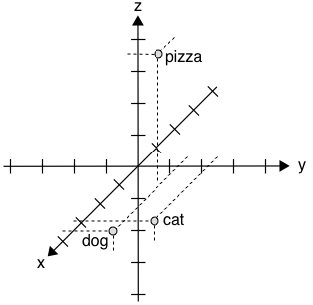
Distributional Word Embeddings
Define dimensions that allow expressing a context
The vector for any particular word captures how strongly it is associated with each context
For instance, on a 3-dimensional space, the axis could have the semantic meaning
x-axis represents some concept of "animal-ness"
z-axis corresponds to "food-ness"
Of course, defining these axes is very difficult
How many?
Hopefully, a lot less than the size of the dictionary (dense vectors)
But at least ~100-dimensional, to be effective
Also, how do we assign the values associated with the vectors?
Tens of millions of numbers to tweak
How about using machine learning models? —> later
3-Dimensions
food-ness
animal-ness
cat = [0.7,0.5,0.1]
dog = [0.8,0.3,0.1]
pizza = [0.1,0.2,0.8]
Notes:
There are hundreds of thousands of unique words in a typical large corpus, and the arrays should be at least around 100-dimensional long to be effective, which means there are more than tens of millions of numbers that you need to tweak.
The idea here is that once all the words in the vocabulary are properly placed in the semantic space, the meaning of a word can be represented by its location in this space—that is, by the coordinates defining its word vector. And what is a word vector good for? It turns out that using word vectors as numerical inputs to represent words, as opposed to the simple one-hot scheme I sketched above, greatly improves the performance of neural networks in NLP tasks.
Mitchell, Melanie. Artificial Intelligence (pp. 189-190). Farrar, Straus and Giroux. Kindle Edition.

Slide 21
Word Embeddings with Machine Learning

Slide 22
How to calculate Word Embeddings?
By calculating co-occurrence counts on the whole dataset
Full document: Latent Semantic Analysis
Window: Singular Value Decomposition (SVD) Based Methods
Iteration Based Methods: learn one iteration (e.g. sentence) at a time
Word2Vec

Slide 23
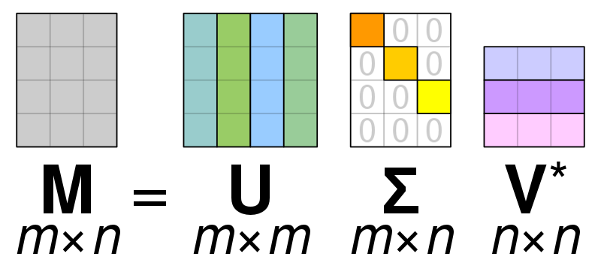
Word-Document Matrix
Words that are related will often appear in the same documents
E.g. banks, bonds, stocks, money, etc. are probably likely to appear together
But banks, octopus, banana, and hockey are probably less likely
Example corpus:
D1: I like deep learning.
D2: I like NLP.
D3: I enjoy flying.
The result is a very large matrix
Size is a function of the number of words and number of documents
Then reduce dimensionality using Singular Value Decomposition (SVD)
Factorization of a matrix in 3x ones
 | D1 | D2 | D3
I | 1 | 1 | 1
Like | 1 | 1 | 0
enjoy | 0 | 1 | 0
deep | 1 | 0 | 0
learning | 1 | 0 | 0
NLP | 0 | 1 | 0
flying | 0 | 0 | 1
. | 1 | 1 | 1
Notes:
As our first attempt, we make the bold conjecture that words that
are related will often appear in the same documents. For instance, "banks", "bonds", "stocks", "money", etc. are probably likely to ap- pear together. But "banks", "octopus", "banana", and "hockey" would probably not consistently appear together. We use this fact to build
a word-document matrix, X in the following manner: Loop over billions of documents and for each time word i appears in document j, we add one to entry Xij. This is obviously a very large matrix (R|V|⇥M) and it scales with the number of documents (M). So perhaps we can try something better.
SVM: Singular Value Decomposition (SVD) is a widely used technique to decompose a matrix into several component matrices, exposing many of the useful and interesting properties of the original matrix.

Slide 24
Window based co-occurrence matrix
Window length 1 (more common: 5–10)
Symmetric (irrelevant whether left or right context)
Example corpus:
D1: I like deep learning.
D2: I like NLP.
D3: I enjoy flying.
 | I | like | enjoy | deep | learning | NLP | flying | .
I | 0 | 2 | 1 | 0 | 0 | 0 | 0 | 0
Like | 2 | 0 | 0 | 1 | 0 | 1 | 0 | 0
enjoy | 1 | 0 | 0 | 0 | 0 | 0 | 1 | 0
deep | 0 | 1 | 0 | 0 | 1 | 0 | 0 | 0
learning | 0 | 0 | 0 | 1 | 0 | 0 | 0 | 1
NLP | 0 | 1 | 0 | 0 | 0 | 0 | 0 | 1
flying | 0 | 0 | 1 | 0 | 0 | 0 | 0 | 1
. | 0 | 0 | 0 | 0 | 1 | 1 | 1 | 0
Notes:
The same kind of logic applies here however, the matrix X stores co-occurrences of words thereby becoming an affinity matrix. In this method we count the number of times each word appears inside a window of a particular size around the word of interest. We calculate this count for all the words in corpus. We display an example below. Let our corpus contain just three sentences and the window size be 1:

Slide 25
Co-Occurrence Vectors
Simple count co-occurrence vectors
Vectors increase in size with vocabulary
Very high-dimensional: require a lot of storage (though sparse)
Subsequent classification models have sparsity issues -> Models are less robust
Low-dimensional vectors
Idea: store “most” of the important information in a fixed, small number of dimensions: a dense vector
Usually 25–1000 dimensions
Dimensionality reduced through Singular Value Decomposition (SVD)
Notes:
we first loop over a massive dataset and accumulate word cooccurrence counts in some form of a matrix X, and then perform Singular Value Decomposition on X to get a USVT decomposition. We then use the rows of U as the word embeddings for all words in our dictionary.
We now perform SVD on X, observe the singular values (the diagonal entries in the resulting S matrix), and cut them off at some index k based on the desired percentage variance captured:
Dimension reduction
Retrain only (the largest) k singular values
Resulting matrix is the best rank-k approximation to the original

Slide 26
Problems with co-occurrence approaches
The calculated word vectors are more than sufficient to encode semantic and syntactic (part of speech) information
But there are many other problems:
The dimensions of the matrix change very often (new words are added very frequently and corpus changes in size)
The matrix is extremely sparse since most words do not co-occur.
The matrix is very high dimensional in general
Very expensive to train (i.e. to perform SVD)
Some clever intervention is needed to adjust the co-occurrence matrix to account for the imbalance in word frequency
Ignore stopwords
Apply a ramp window – i.e. weight the co-occurrence count based on the distance between the words in the document.
Use Pearson correlation and set negative counts to 0 instead of using just raw count
Iteration-based methods solve many of these issues

Slide 27
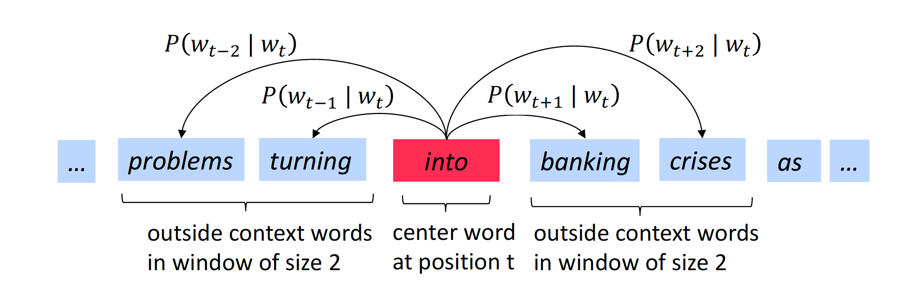
Iteration Based Methods - Word2Vec
Idea: Design a model whose parameters are the word vectors
Train a simple neural network with a single hidden layer, using a certain objective
At every iteration, evaluate the errors, penalize the model parameters that caused the error
How?
Consider a large corpus of text
Define a vocabulary of words and associate each word to a row of the embedding matrix initialised at random
Go through each position in the text, which has a centre word and a context around it (fixed window)
Adjust the word vectors to minimise a prediction error
Predicting what?
Estimate the probability of context given the centre word (SKIPGRAM)
Estimate the probability of the centre word given its context (CBOW)
HINT: Calculating the probability P of each word occurring in the vicinity of the center word and within a specified window
Notes:
vector”). The word2vec method uses a traditional neural network to automatically learn word vectors for all the words in a vocabulary.
Let’s start with a high-level insight into where we’re going. Word2Vec uses a trick you may have seen elsewhere in machine learning. We’re going to train a simple neural network with a single hidden layer to perform a certain task, but then we’re not actually going to use that neural network for the task we trained it on! Instead, the goal is actually just to learn the weights of the hidden layer–we’ll see that these weights are actually the “word vectors” that we’re trying to learn.
Instead of computing and storing global information about some huge dataset (which might be billions of sentences), we can try to create a model that will be able to learn one iteration at a time and eventually be able to encode the probability of a word given its context.
The idea is to design a model whose parameters are the word vectors. Then, train the model on a certain objective. At every iteration we run our model, evaluate the errors, and follow an update rule that has some notion of penalizing the model parameters that caused the error. Thus, we learn our word vectors.

Slide 28
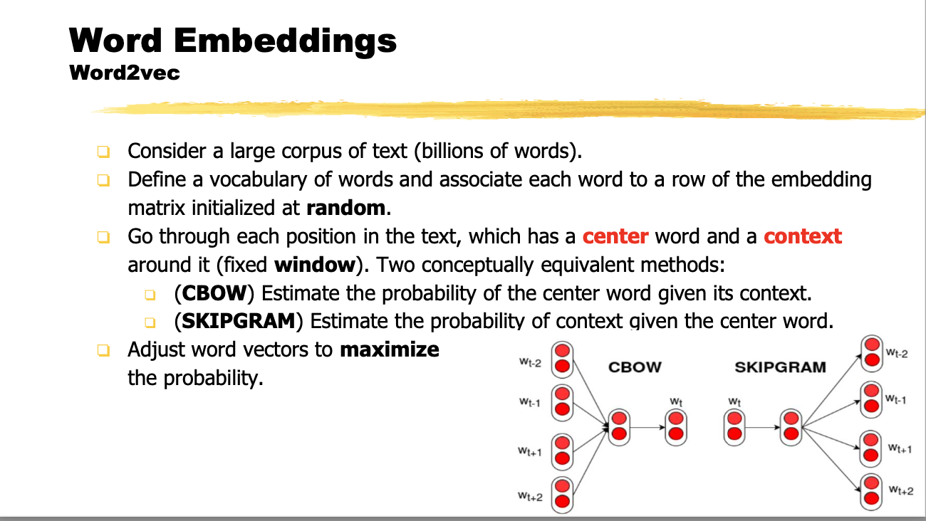
SKIPGRAM
Predicts the probability of context words from a centre word
Input: one-hot vector of the centre word (size of the vocabulary)
Output: a single vector; for every word the probability that a word is selected to be in the context window
When training this network on word pairs, the input is a one-hot vector representing the input word and the training output is also a one-hot vector representing the output word
Each word is generated multiple times
each time it is conditioned only on a single word
tezgüino
??
??
??
??

Slide 29
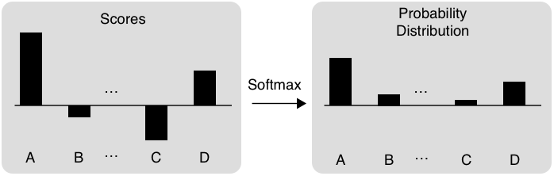
SKIPGRAM Example
This is the word vector that we want to learn
One-hot input vector
Size of vocabulary
http://mccormickml.com/2016/04/19/word2vec-tutorial-the-skip-gram-model/
Notes:
We’re going to train the neural network to do the following. Given a specific word in the middle of a sentence (the input word), look at the words nearby and pick one at random. The network is going to tell us the probability for every word in our vocabulary of being the “nearby word” that we chose.
When I say "nearby", there is actually a "window size" parameter to the algorithm. A typical window size might be 5, meaning 5 words behind and 5 words ahead (10 in total).
The output probabilities are going to relate to how likely it is to find each vocabulary word nearby our input word. For example, if you gave the trained network the input word “Soviet”, the output probabilities are going to be much higher for words like “Union” and “Russia” than for unrelated words like “watermelon” and “kangaroo”.
We’ll train the neural network to do this by feeding it word pairs found in our training documents. The below example shows some of the training samples (word pairs) we would take from the sentence “The quick brown fox jumps over the lazy dog.” I’ve used a small window size of 2 just for the example. The word highlighted in blue is the input word.
The network is going to learn statistics from the number of times each pairing shows up. So, for example, the network is probably going to get many more training samples of (“Soviet”, “Union”) than it is of (“Soviet”, “Sasquatch”). When the training is finished, if you give it the word “Soviet” as input, then it will output a much higher probability for “Union” or “Russia” than it will for “Sasquatch”.
First of all, you know you can’t feed a word just as a text string to a neural network, so we need a way to represent the words to the network. To do this, we first build a vocabulary of words from our training documents–let’s say we have a vocabulary of 10,000 unique words.
We’re going to represent an input word like “ants” as a one-hot vector. This vector will have 10,000 components (one for every word in our vocabulary) and we’ll place a “1” in the position corresponding to the word “ants”, and 0s in all of the other positions.
The output of the network is a single vector (also with 10,000 components) containing, for every word in our vocabulary, the probability that a randomly selected nearby word is that vocabulary word.
Here’s the architecture of our neural network.
Skip-gram Neural Network Architecture
There is no activation function on the hidden layer neurons, but the output neurons use softmax. We’ll come back to this later.
When training this network on word pairs, the input is a one-hot vector representing the input word and the training output is also a one-hot vector representing the output word. But when you evaluate the trained network on an input word, the output vector will actually be a probability distribution (i.e., a bunch of floating point values, not a one-hot vector).

Slide 30
CBOW - Continous Bag of Word
Predict a centre word from the surrounding context in terms of word vectors
Bag-of-words model: because the order of the context words does not matter
Continuous: condition on a continuous vector constructed from the word embeddings
Input: multiple one-hot vectors (one per context word)
Output: a single vector, for every word the probability that a word is selected to be the right one for the context
The dimension of the hidden layer is the same as for SKIPGRAM
SKIPGRAM: works well with a small amount of the training data, represents well even rare words or phrases.
CBOW: several times faster to train than the skip-gram, slightly better accuracy for the frequent words.
a
bottle
of
is
on
the
??

Slide 31
Issues
Results are in general impressive, but:
Multi-sense words (e.g. bank)
Possible solution: multi-sense word embeddings
Fixed-size vocabulary: new words are not learned
Out of Vocabulary words are represented with the same dense vector
No information about sub-word structure: morphology is completely ignored
Possible solution: character-based word representation
e.g. Facebook’s FastText (https://fasttext.cc)

Slide 32
Using Word Embeddings

Slide 33
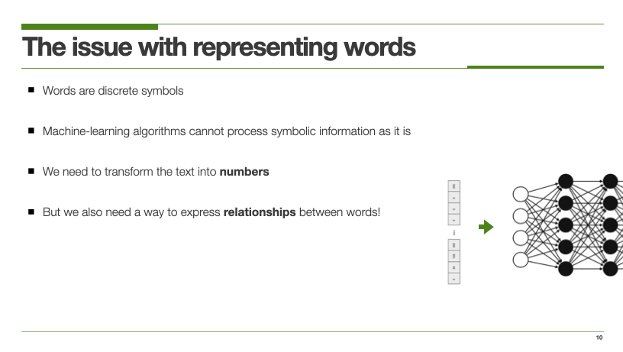
Why are embeddings important
They are essential for using neural networks to solve NLP tasks
They bridge the symbolic (discrete) world of words with the numerical (continuous) world of neural networks

Slide 34
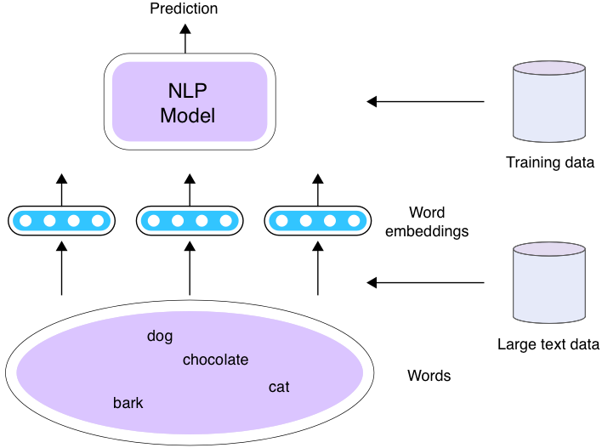
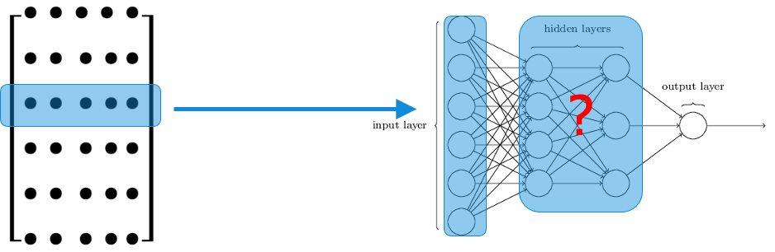
How can embeddings be used with NLP Models?
Word embeddings can be trained, but sometimes you just want to reuse them
Three scenarios
Scenario 1: Train word embeddings and your model at the same time using the train set for your task
Scenario 2: initialize your model using the pre-trained word embeddings, and train them (fine-tune) and your model at the same time using the train set for your task
A large amount of plain text data (e.g. Wikipedia dumps), which are usually more readily available than the train datasets for your task
This is an example of transfer learning
Scenario 3: Same as Scenario 2, except you fix word embeddings while you train your model

Slide 35
Use Word2vec in your work
Easiest way to use it is via the Gensim library for Python (tends to be slow, even though it tries to use C optimizations like Cython, NumPy)
https://radimrehurek.com/gensim/models/word2vec.html
Original word2vec C code by Google
https://code.google.com/archive/p/word2vec/
Use pre-trained word vectors whenever possible
Glove: https://nlp.stanford.edu/projects/glove/
fastText: https://fasttext.cc/docs/en/english-vectors.html

Slide 36
Evaluating Word Embeddings

Slide 37
How to evaluate word vectors?
Related to a general evaluation in NLP: Intrinsic vs. extrinsic
Intrinsic: evaluation on a specific/intermediate subtask [analogy]
Fast to compute
Helps to understand that system
Not clear if really helpful unless correlation to the real task is established
Extrinsic: evaluation on a real task
Can take a long time to compute the accuracy
Unclear if the subsystem is the problem or it is an interaction with other subsystems

Slide 38
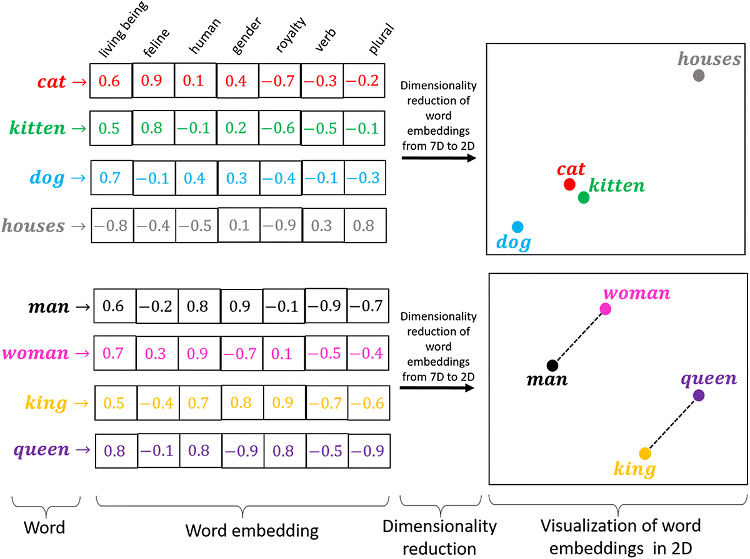
Dimensionality Reduction

Slide 39
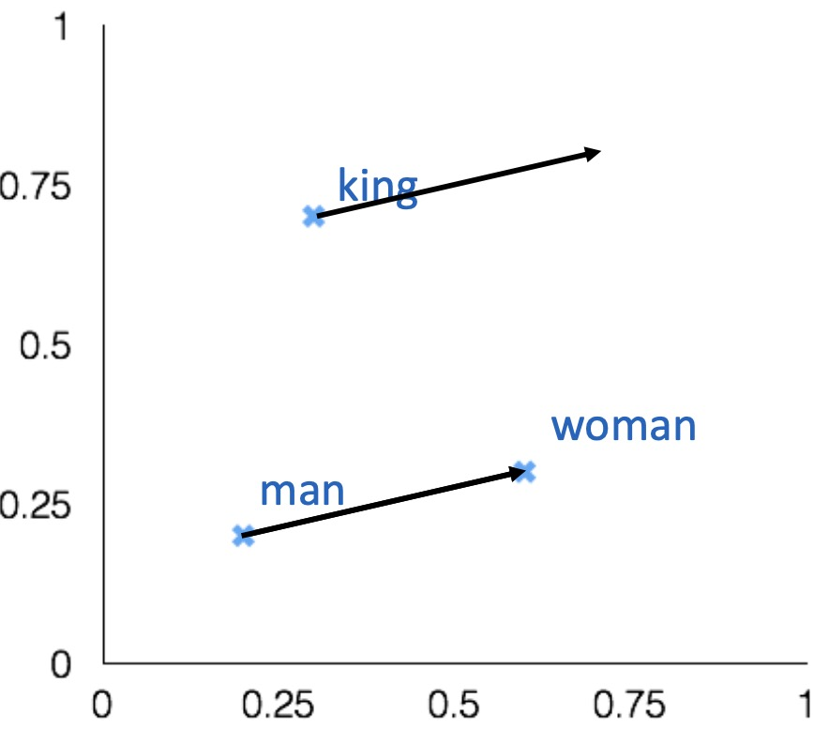
Intrinsic word evaluation
Word vector analogies
Evaluation: find a word such that the vector is closest to vec[man]-vec[woman]+vec[king] according to the cosine similarity
Correct if the word found is queen
Can be applied to test for syntactic analogy as well
Quick:quickly = slow:slowly
a:b = c:?
man:woman = king: ?
Notes:
Let’s remember that the goal of this whole process is to find a numerical representation—a vector—for each word in the vocabulary, one that captures something of the semantics of the word. The hypothesis is that using such word vectors will result in high-performing neural networks for natural-language processing tasks. But to what extent does the “semantic space” created by word2vec actually capture word semantics? This question is hard to answer, because we can’t visualize the three-hundred-dimensional semantic space learned by word2vec. However, we can do a few things to glimpse into this space. The simplest approach is to take a given word and find the words that have ended up closest to it in the semantic space, by looking at the distances between word vectors.
Mitchell, Melanie. Artificial Intelligence (p. 193). Farrar, Straus and Giroux. Kindle Edition.

Slide 40
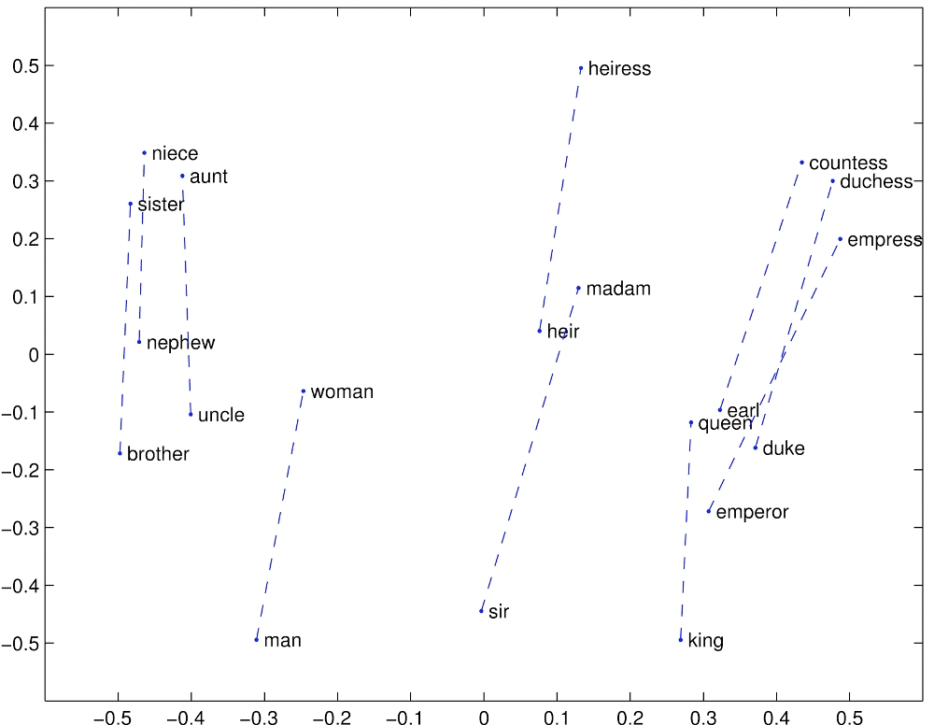
Gender relation

Slide 41
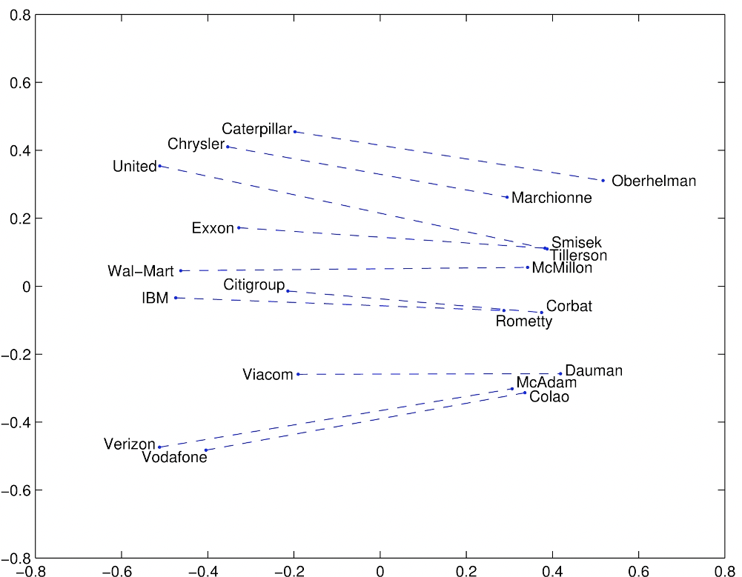
Company - CEO

Slide 42
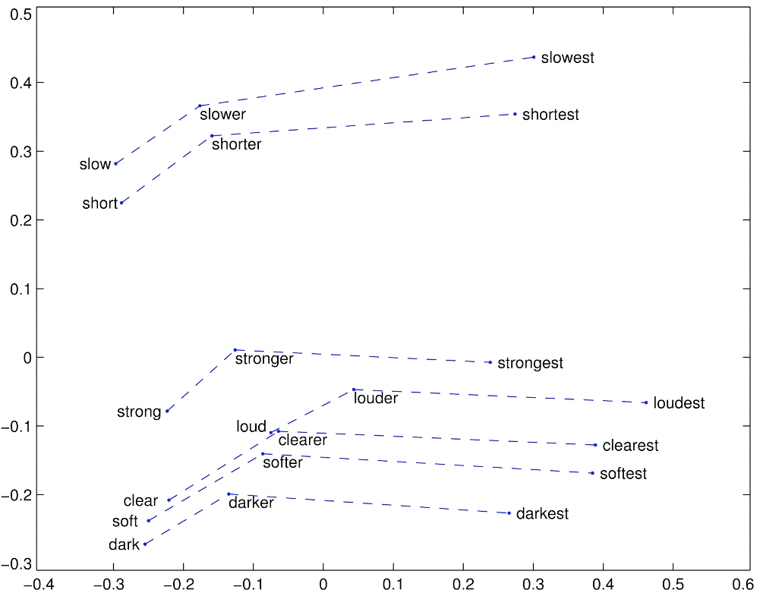
Comparatives and Superlatives

Slide 43
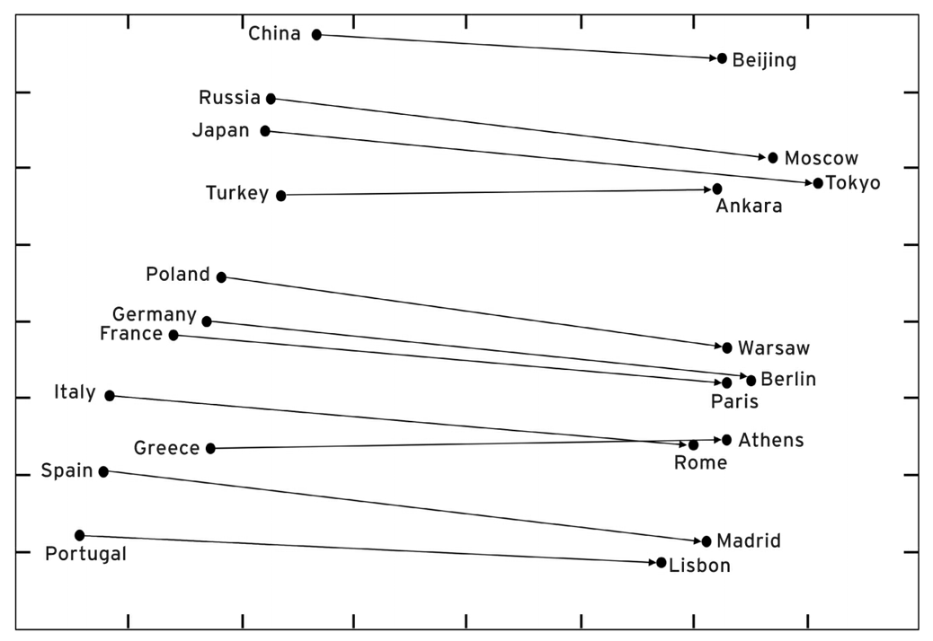
Countries and their capital

Slide 44
But are word embeddings that good?
By exploring the semantic space, you can also find analogies like
Thirsty is to drink as tired is to drunk
Fish is to water as bird is to hydrant
Notes:
Several groups have shown that these word vectors, perhaps unsurprisingly, capture the biases inherent in the language data that produces them.
So much for decades of feminism. We can’t blame the word vectors; they simply capture sexism and other biases in our language, and our language reflects biases in our society. But blameless as word vectors may be, they are a key component in every modern NLP system, ranging from speech recognition to language translation.

Slide 45
But are word embeddings that good?
By exploring the semantic space, you can also find analogies like
Thirsty is to drink as tired is to drunk
Fish is to water as bird is to hydrant
Man is to woman as computer programmer is to ______
Woman is to man as computer programmer is to ______
Man is to genius as woman is to______
Woman is to genius as man is to ______

Slide 46
But are word embeddings that good?
By exploring the semantic space, you can also find analogies like
Thirsty is to drink as tired is to drunk
Fish is to water as bird is to hydrant
Man is to woman as computer programmer is to ______
Woman is to man as computer programmer is to ______
Man is to genius as woman is to______
Woman is to genius as man is to ______
Biases in word vectors might seep through to produce unexpected, hard-to-predict biases in widely used NLP applications
Homemaker
Mechanical engineer
muse
geniuses

Slide 47
Extra:
Recurrent Neural Networks

Slide 48
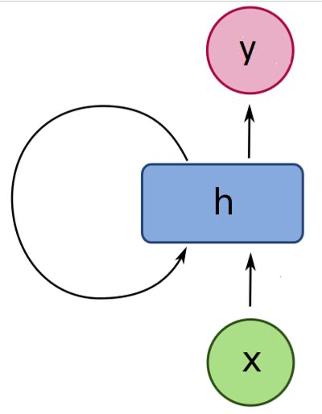
Recurrent Neural Network
Traditional neural networks can consider only a finite window of previous words
Also, the behaviour does not depend on the order in which inputs are presented
Recurrent Neural Networks are capable of conditioning the model on ALL previous words
inspired by ideas on how the brain interprets sequences
The hidden state has feedback connections that pass information about the past to the next input
Output can be produced at any step or only at the end of the sequence
How to train an RNN?
feedback connections create loops, which is a problem since the update of weight depends on itself at the previous time step.
Solution: a recurrent neural network processing a sequence of length T is equivalent to a feedforward network obtained by the unfolding of the RNN T times
The unfolded network is trained with standard backpropagation with weight sharing
Notes:
The amount of memory required to run a layer of RNN is proportional to the number of words in the corpus. For instance, a sentence with k words would have k word vectors to be stored in memory.
inspired, of course, by ideas on how the brain interprets sequences. Imagine that you are asked to read the review “A little too dark for my taste” and classify it as having positive or negative sentiment. You read the sentence left to right, one word at a time. As you read it, you start to form impressions of its sentiment, which become further supported as you finish reading the sentence. At this point, your brain has some kind of representation of the sentence in the form of neural activations, which allow you to confidently state whether the review is positive or negative.
How does this work? Unlike a traditional neural network, an RNN operates over a series of time steps. At each time step, the RNN is fed an input and computes the activation of its hidden and output units just as does a traditional neural network. But in an RNN each hidden unit computes its activation based on both the input and the activations of the hidden units from the previous time step. (At the first time step, these recurrent values are set to 0.) This gives the network a way to interpret the words it “reads” while remembering the context of what it has already “read.”

Slide 49
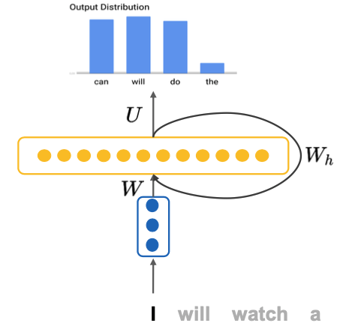

Slide 50
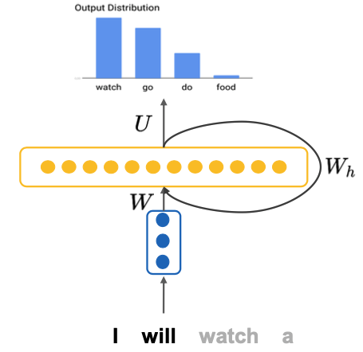

Slide 51
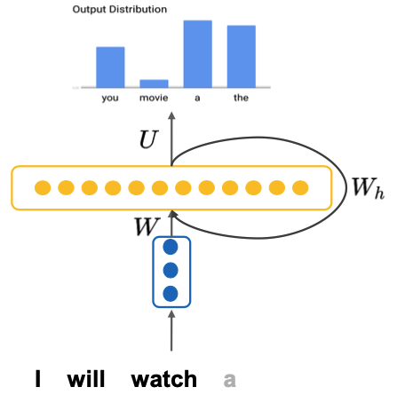

Slide 52
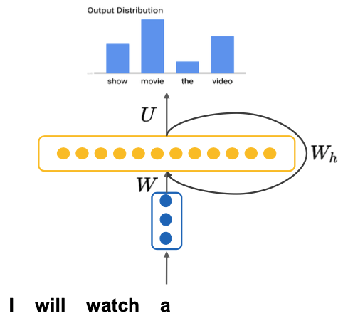

Slide 53
What are RNNs for?
Recurrent Neural Networks can be used in a variety of scenarios depending on how the inputs are fed and the outputs are interpreted
Sequential input to sequential output
Machine translation / part-of-speech tagging and language modelling tasks lie within this class
Sequential input to single output.
e.g sentiment analysis, in which we fed a sentence and we want to classify it as positive, neutral or negative
Single input to sequential output
e.g. image captioning: where we fed a picture to the RNN and want to generate a description of it

Slide 54
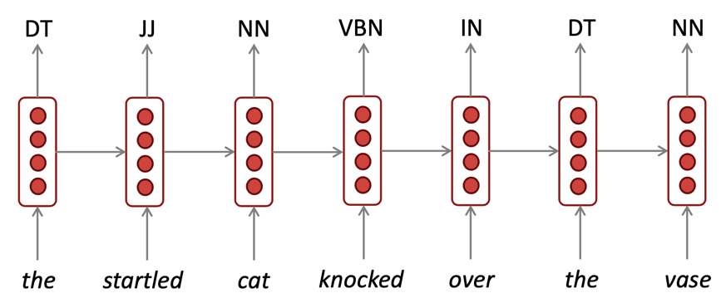
RNNs can be used for tagging
e.g., part-of-speech tagging, named entity recognition

Slide 55
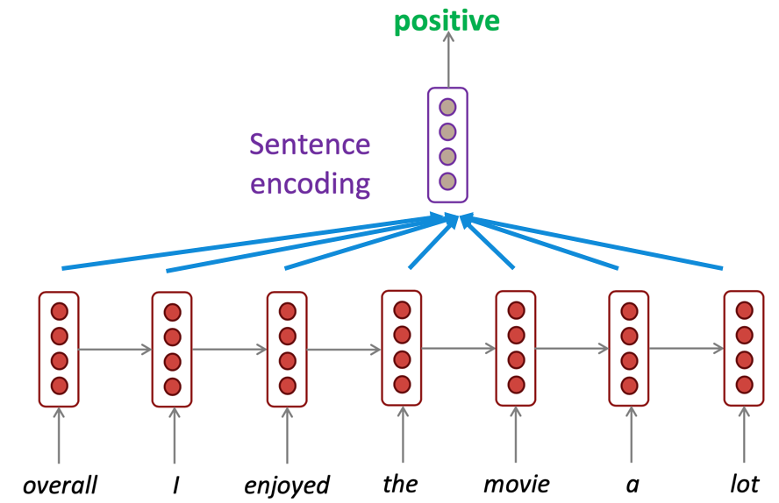
Sentence Classification
e.g., sentiment classification

Slide 56
Pros and cons
RNN Advantages:
Can process any input length
Computation for step t can (in theory) use information from many steps back
Model size doesn’t increase for longer input context
RNN Disadvantages:
Recurrent computation is slow
In practice, difficult to access information from many steps back (gradient vanishing problem)
http://neuralnetworksanddeeplearning.com/chap5.html#the_vanishing_gradient_problem

Slide 57
Admin

Slide 58
Advanced Machine Learning For Design
Lecture 3 - Machine Learning and Natural Language Processing / Part 2
Evangelos Niforatos
04/10/2023
aml4d-ide@tudelft.nl
https://aml4design.github.io/

Slide 59
Sources
CIS 419/519 Applied Machine Learning. Eric Eaton, Dinesh Jayaraman. https://www.seas.upenn.edu/~cis519/spring2020/
EECS498: Conversational AI. Kevin Leach. https://dijkstra.eecs.umich.edu/eecs498/
CS 4650/7650: Natural Language Processing. Diyi Yang. https://www.cc.gatech.edu/classes/AY2020/cs7650_spring/
Natural Language Processing. Alan W Black and David Mortensen. http://demo.clab.cs.cmu.edu/NLP/
IN4325 Information Retrieval. Jie Yang.
Speech and Language Processing, An Introduction to Natural Language Processing, Computational Linguistics, and Speech Recognition. Third Edition. Daniel Jurafsky, James H. Martin.
Natural Language Processing, Jacob Eisenstein, 2018.

Slide 60
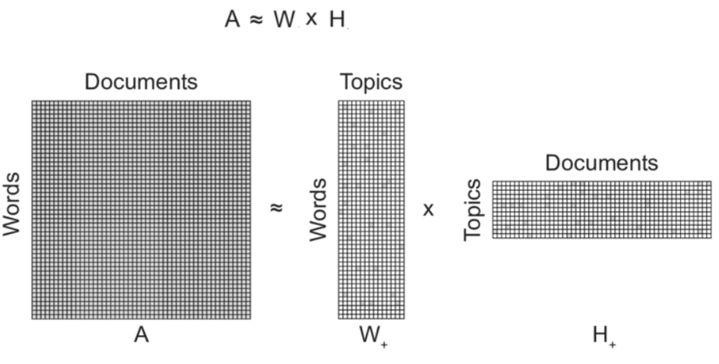
TO FIX
Next time include 1-2x slides on how LDA algorithm works because students were particularly interested especially during the tutorials

